Slide 1
PULSE 2.0
By Team Dynamic Dudes

Slide 2


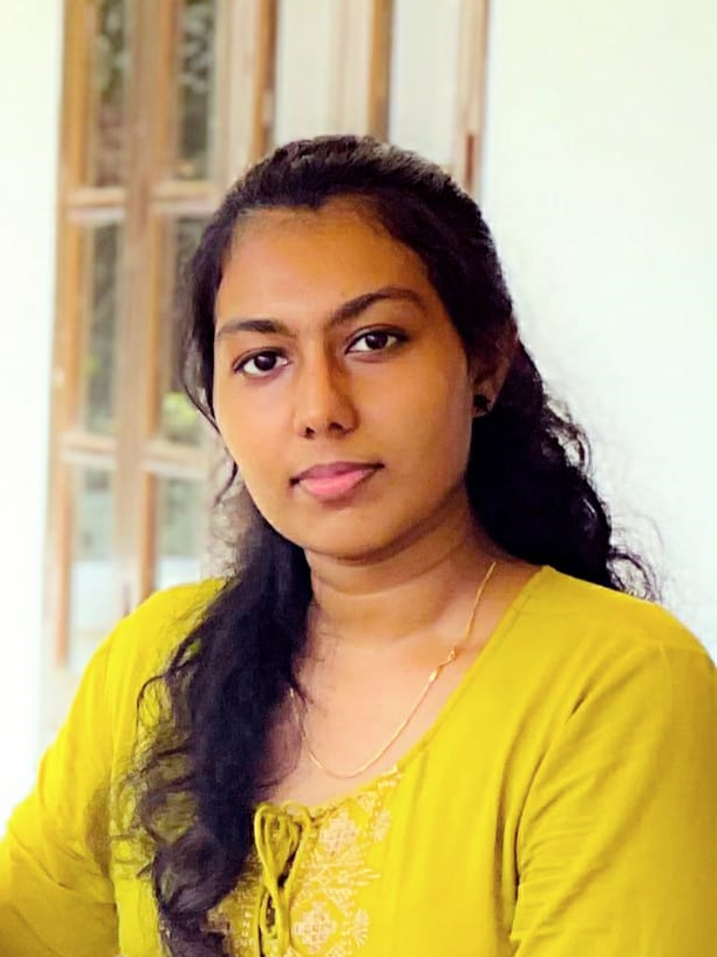

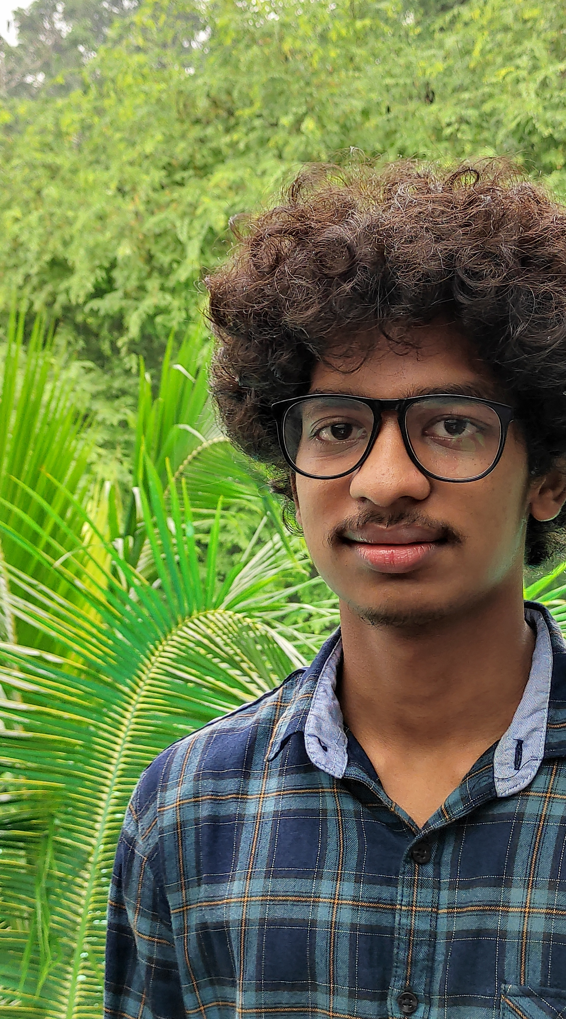
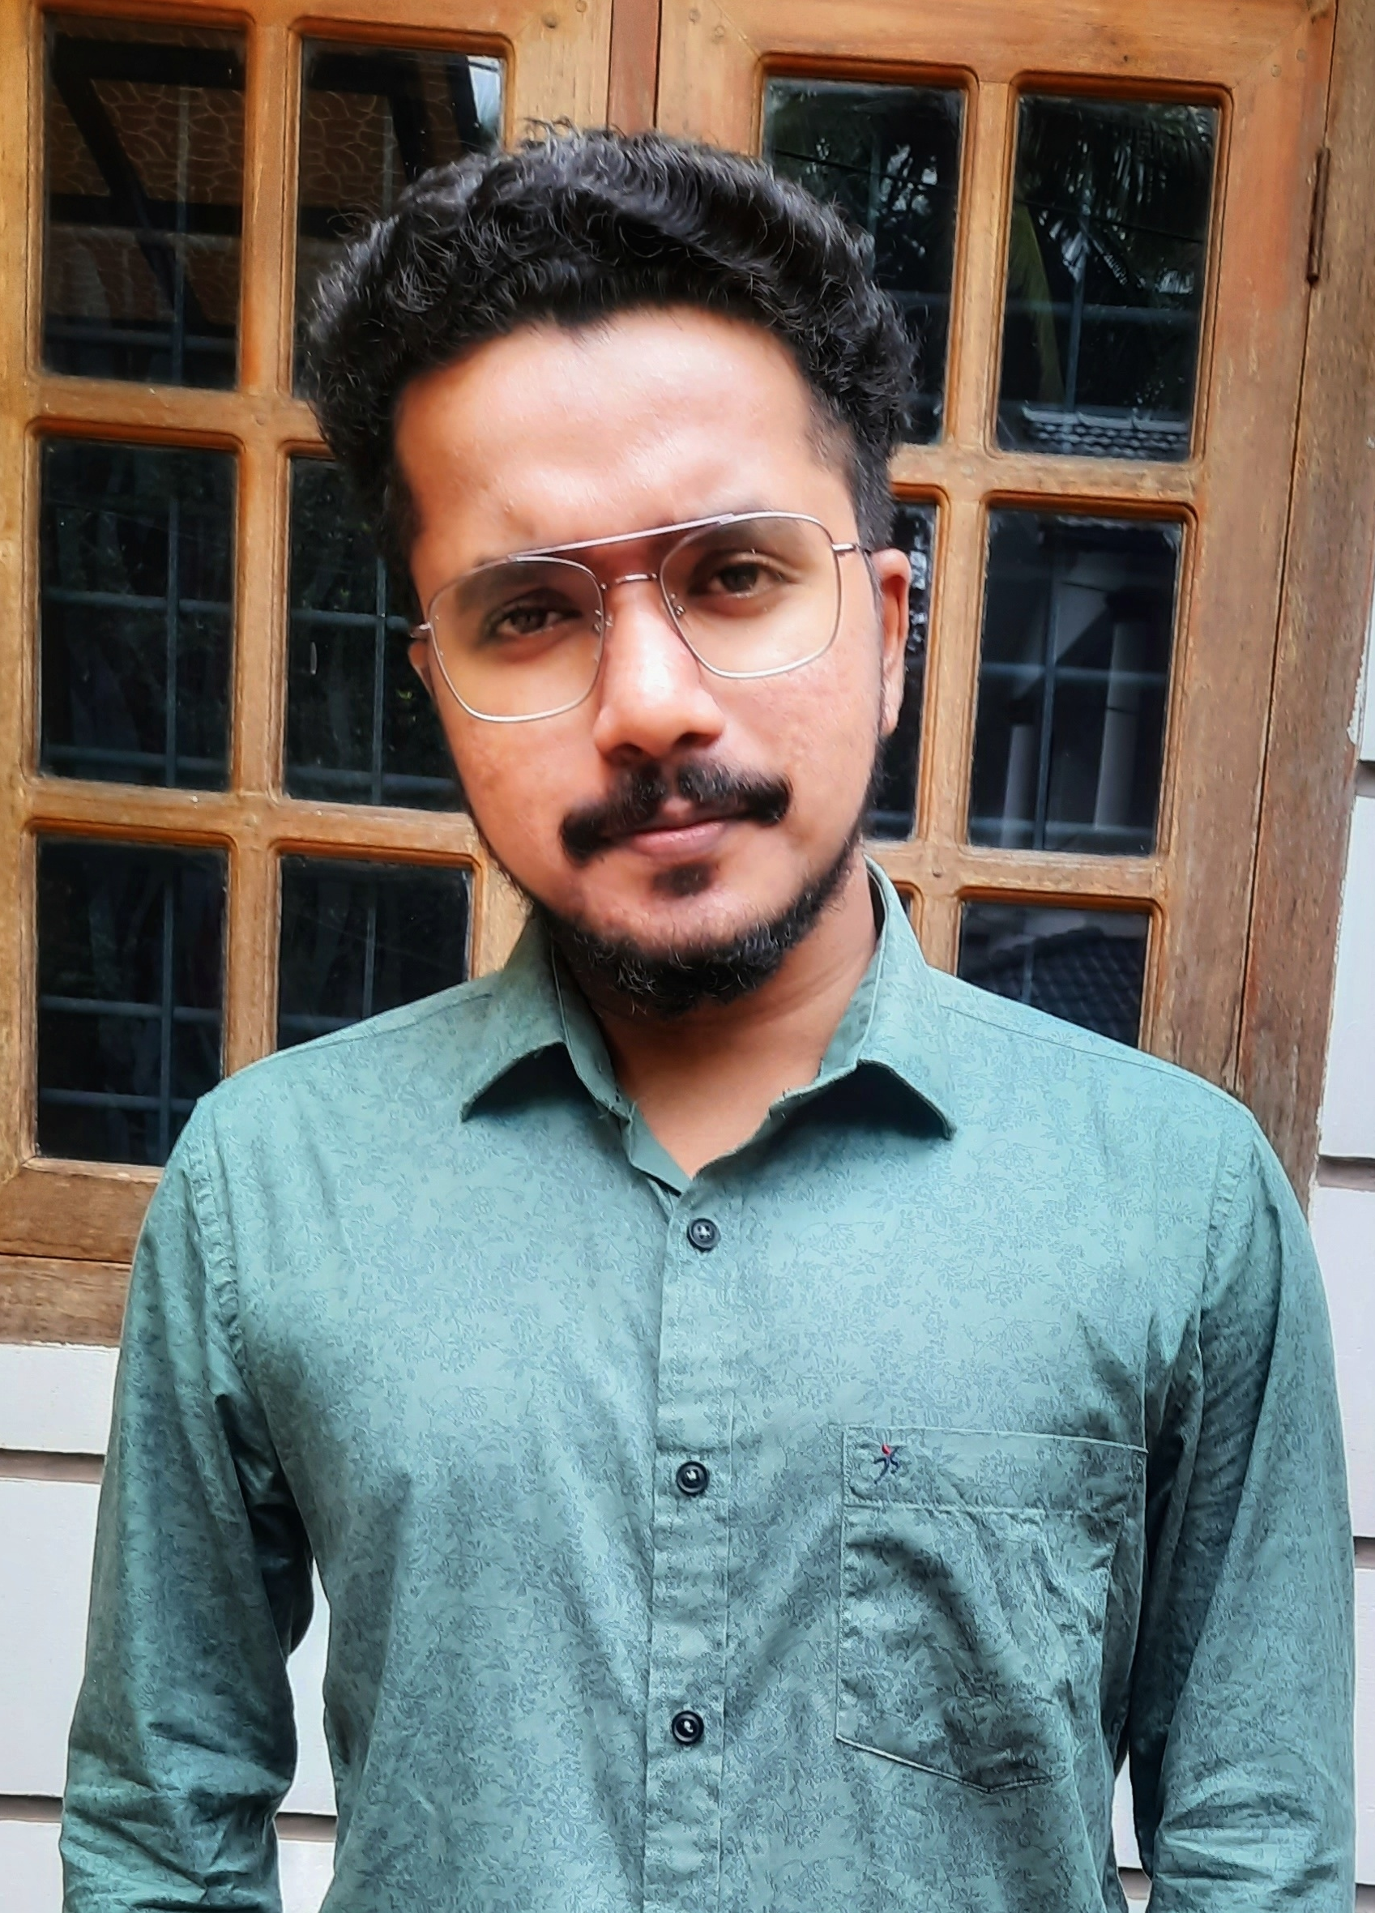
Team Dynamic Dudes
Mentor :
Prof. Anas MM
Basil Reji
Ashmika K
Associate Professor
S6 ECE,
S6 ECE,
Department of ECE
GEC Wayanad
GEC Wayanad
GEC Wayanad
Anusha
Mohammed
Suresh VM
Binoy SS
Arif P
S6 ECE,
S6 ECE,
S6 ECE,
GEC Wayanad
GEC Wayanad
GEC Wayanad

Slide 3
Rs. 50,000 Cr
According to the Economic Times,
Crops worth,
Are lost a year due to pest and diseases

Slide 4
“ Majority of that was spoiled by the lack of proper disease detection. Most of the time this is due to lack of proper maintenance. “

Slide 5
Farmers and agricultural field officers needs to Cope with climate change, soil erosion and biodiversity loss Satisfy consumers’ changing tastes and expectations Meet rising demand for more food of higher quality Invest in farm productivity

Slide 6
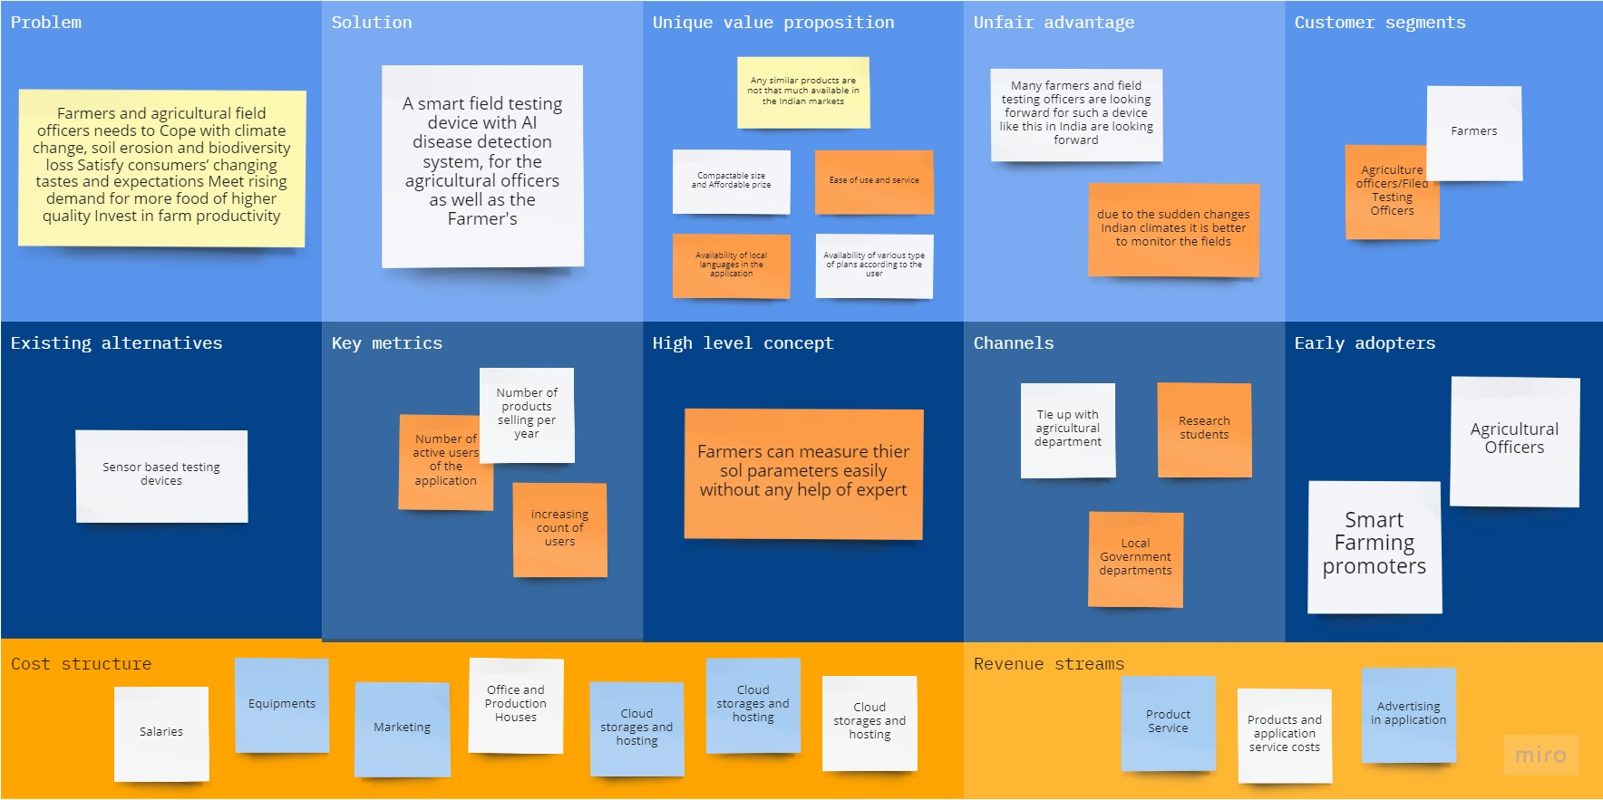
Lean Canvas

Slide 7
PULSE 2.0
A smart field testing device with AI disease detection system, for the agricultural officers as well as the Farmer's

Slide 8
System Overview
Pulse 2.0
Hardware
Software
Microcontroller
Sensors
Application
Cloud

Slide 9
MQTT
ESP 32
Humidity
Sensor
Soil Moisture
Sensor
Temperature
Sensor
Electric Conductivity
Sensor
pH Sensor
Hardware

Slide 10
MQTT
MQTT
Applictation
Cloud
AI Disease Detection System
Chatbot (AgriBot)
Displaying values
and Graph
( Which will be deployed in Amazon Alexa, Google Assistant and Apple Siri )
Software

Slide 11
AI Disease Detection Flow chart
Image From the Camera
Image Processing
Machine Learning
Deep Learning
CNN
SVM
RNN
Decision Making Logic

Slide 12
AI – Decision Making Truth Table
Image Processing Result | DL Result | ML result | Decision
1 | 1 | 1 | Disease Identified
0 | 1 | 1 | Doubtful Result
1 | 1 | 0 | Doubtful Result
1 | 0 | 1 | Doubtful Result
0 | 0 | 1 | Doubtful Result
0 | 1 | 0 | Doubtful Result
1 | 0 | 0 | Doubtful Result
0 | 0 | 0 | No Disease

Slide 13
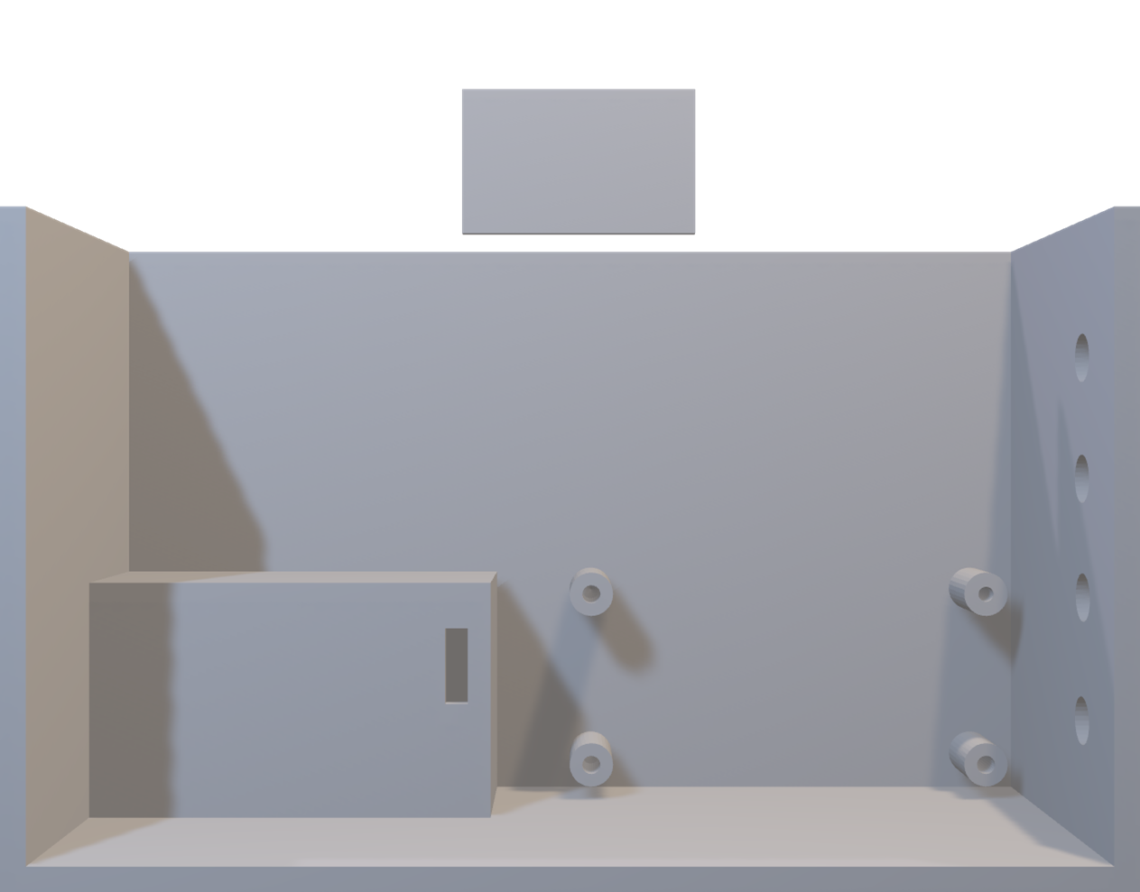
Basic structure of the design
Microcontroller
Battery Compartment
Connector Pins

Slide 14
Advantages
Easy to use
Less Power Consumption
Affordable prize
Portable
Updated Data Set’s
Security of data
Local and Cloud storage Facility
Data driven graphs
Long Life
Water and Mud resistant
Most of the functions works at offline

Slide 15
Conductivity Sensor - 250 INR Microcontroller - 350 INR Humidity Sensor - 150 INR PH sensor - 1999 INR Temperature Sensor - 150 INR Soil Moiture Sensor - 100 INR
Development Cost
Hardware - 2849 INR
Software Development Cost - 1,00,000 INR
Cloud Hosting Cost - From 5000+ INR/year
(Depends upon the users)

Slide 16
Why Now?
It is just because nowadays technology is influencing each and every field, as a part of which we decided to get into agricultural field. This will highly brings the graph up for agriculture by improving the quality of crops as well as helps in the involvement of younger generation to farming

Slide 17
Market Potential
- Many farmers and field testing officers are looking forward for such a device like this in India are looking forward for such a field testing system
- Due to the sudden changes Indian climates it is better to monitor the fields
- Any similar products are not that much available in the Indian markets

Slide 18
User Prize
Hardware – Rs. 5000
Golden
Silver
Bronze
Cloud Storage & Local Storage
Previous Data Analysis
Disease Detection System
Local Mapping Facility
Sensors Data
Previous Data Analysis
Disease Detection System
Sensors Data
Local Storage Facilities up to 1 month
Sensors Data
Very Recent Data’s
Rs. 300/Month
Rs. 200/Month
Rs. 100/Month

Slide 19
Planning and Paper Works
(1 Month)
Field Testing and
Analyzing
(1 Month)
User’s Testing,
Problem Identification and Debuggng
(3 Month)
Final Product Launch
1
3
5
7
2
4
6
Proto Typing
(3 Months)
Product Development
(1 Months)
Modification’s
According to the responses from the test users
1 Month
Roadmap

Slide 20

Thanks!
Any questions?
Team Dynamic Dudes

Slide 21
Financials

